Slide 1
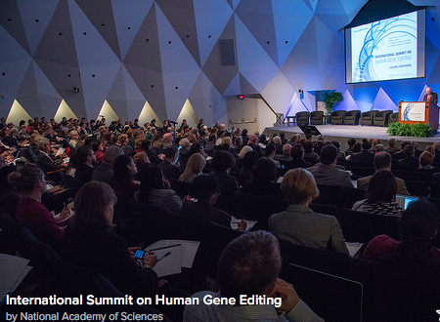
The Sciences of Human Genome Editing

Slide 2
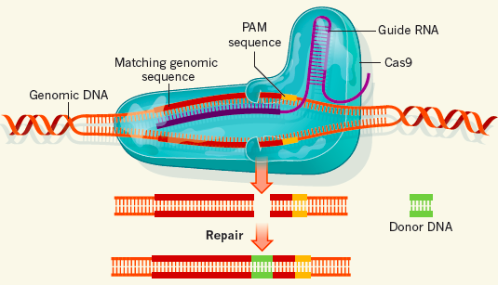
Genome Editing & CRISPR/Cas9
Genome editing tools can add, delete or inactivate a gene,
or make targeted alterations
Not a new concept; in use
for a number of years
Specific DNA recognition
precisely targets DNA cutting
Cellular repair mechanisms
used to introduce changes
CRISPR/Cas9
(Charpentier & Doudna, 2013)
RNA-guided, rather than protein-guided like the earlier editing tools
More efficient, less costly, more versatile, guide RNAs easily synthesised
Can also be used to make single base edits, turn genes on and off, etc.
Explosion of use in basic research demonstrates rapid advances possible
Notes:
-editing CRISPR has set off an intense interest and adoption, mention ZFN and TALENS as other tools
From a scientific standpoint
Genome editing is a type of gene therapy

Slide 3
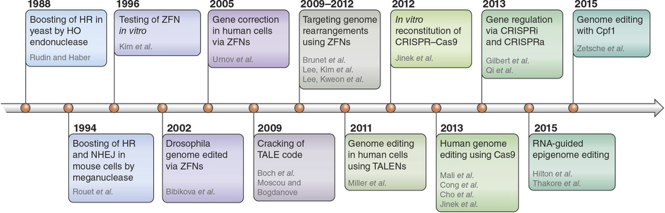
History of genome editing
Nature Protocols, 11, 1573–1578 (2016)
Main tools：
ZFN，Sangamo
TALEN, faster and more accurate than ZFN
CRISPR-Cas9 easy and widely available
Notes:
基因编辑技术的发展

Slide 4
The Science of Human Genome Editing
Moderator: Duanqing PEI, GIBH, CAS
Speakers:
Feng Zheng, Broad Institute
David R. Liu, Broad Institute
Angelo Lombardo, San Raffaele University
Jennifer Doudna, University of California, Berkeley

